Slide 1
Layers Types
Lecture 4/10

Slide 2
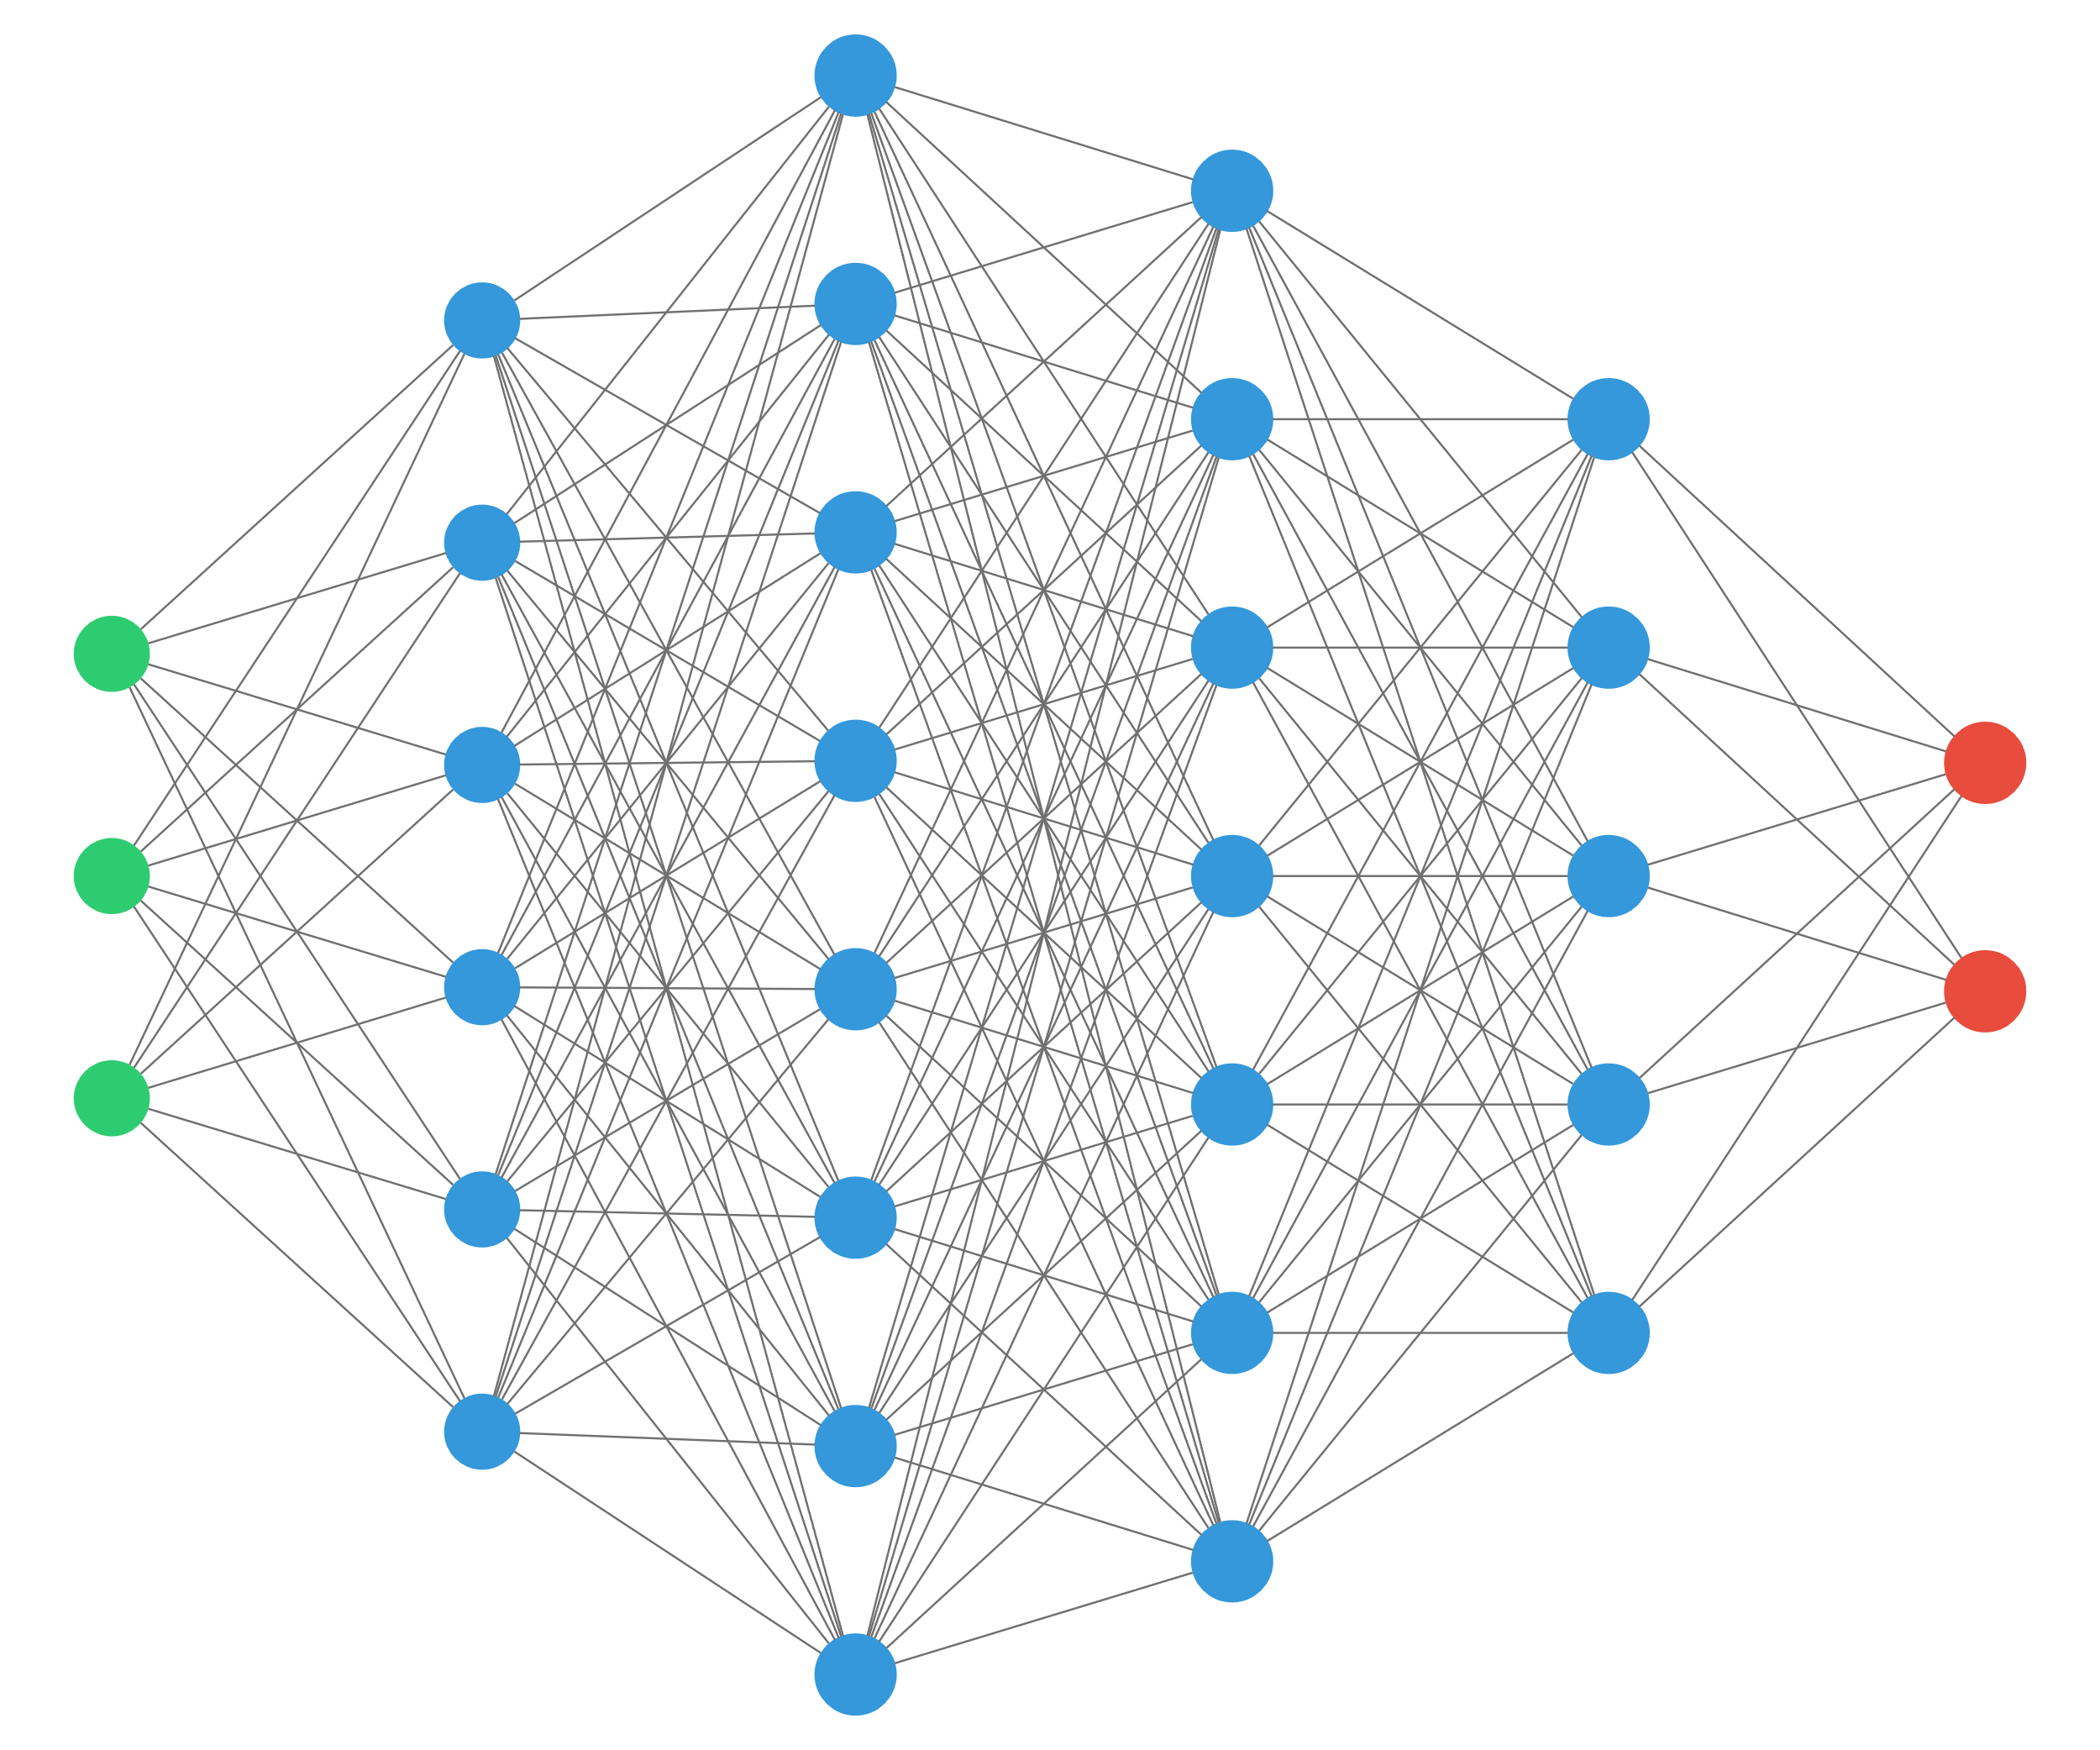
Preceptrons

Slide 3
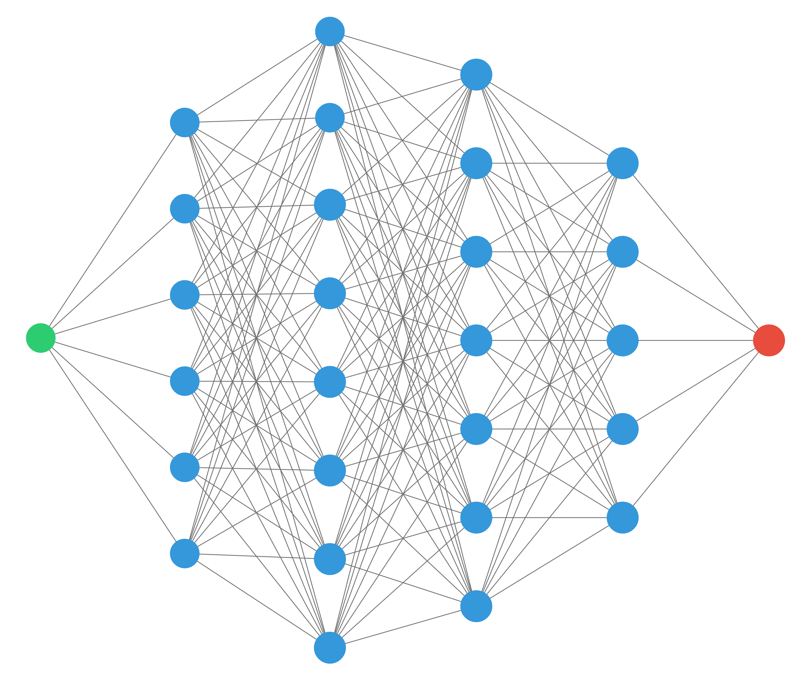
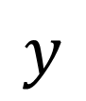
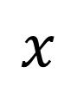
1D perceptron
$$x$$
$$y$$
“any continuous function can be approximated by a 2 layers perceptron” (with ReLU activation)

Slide 4
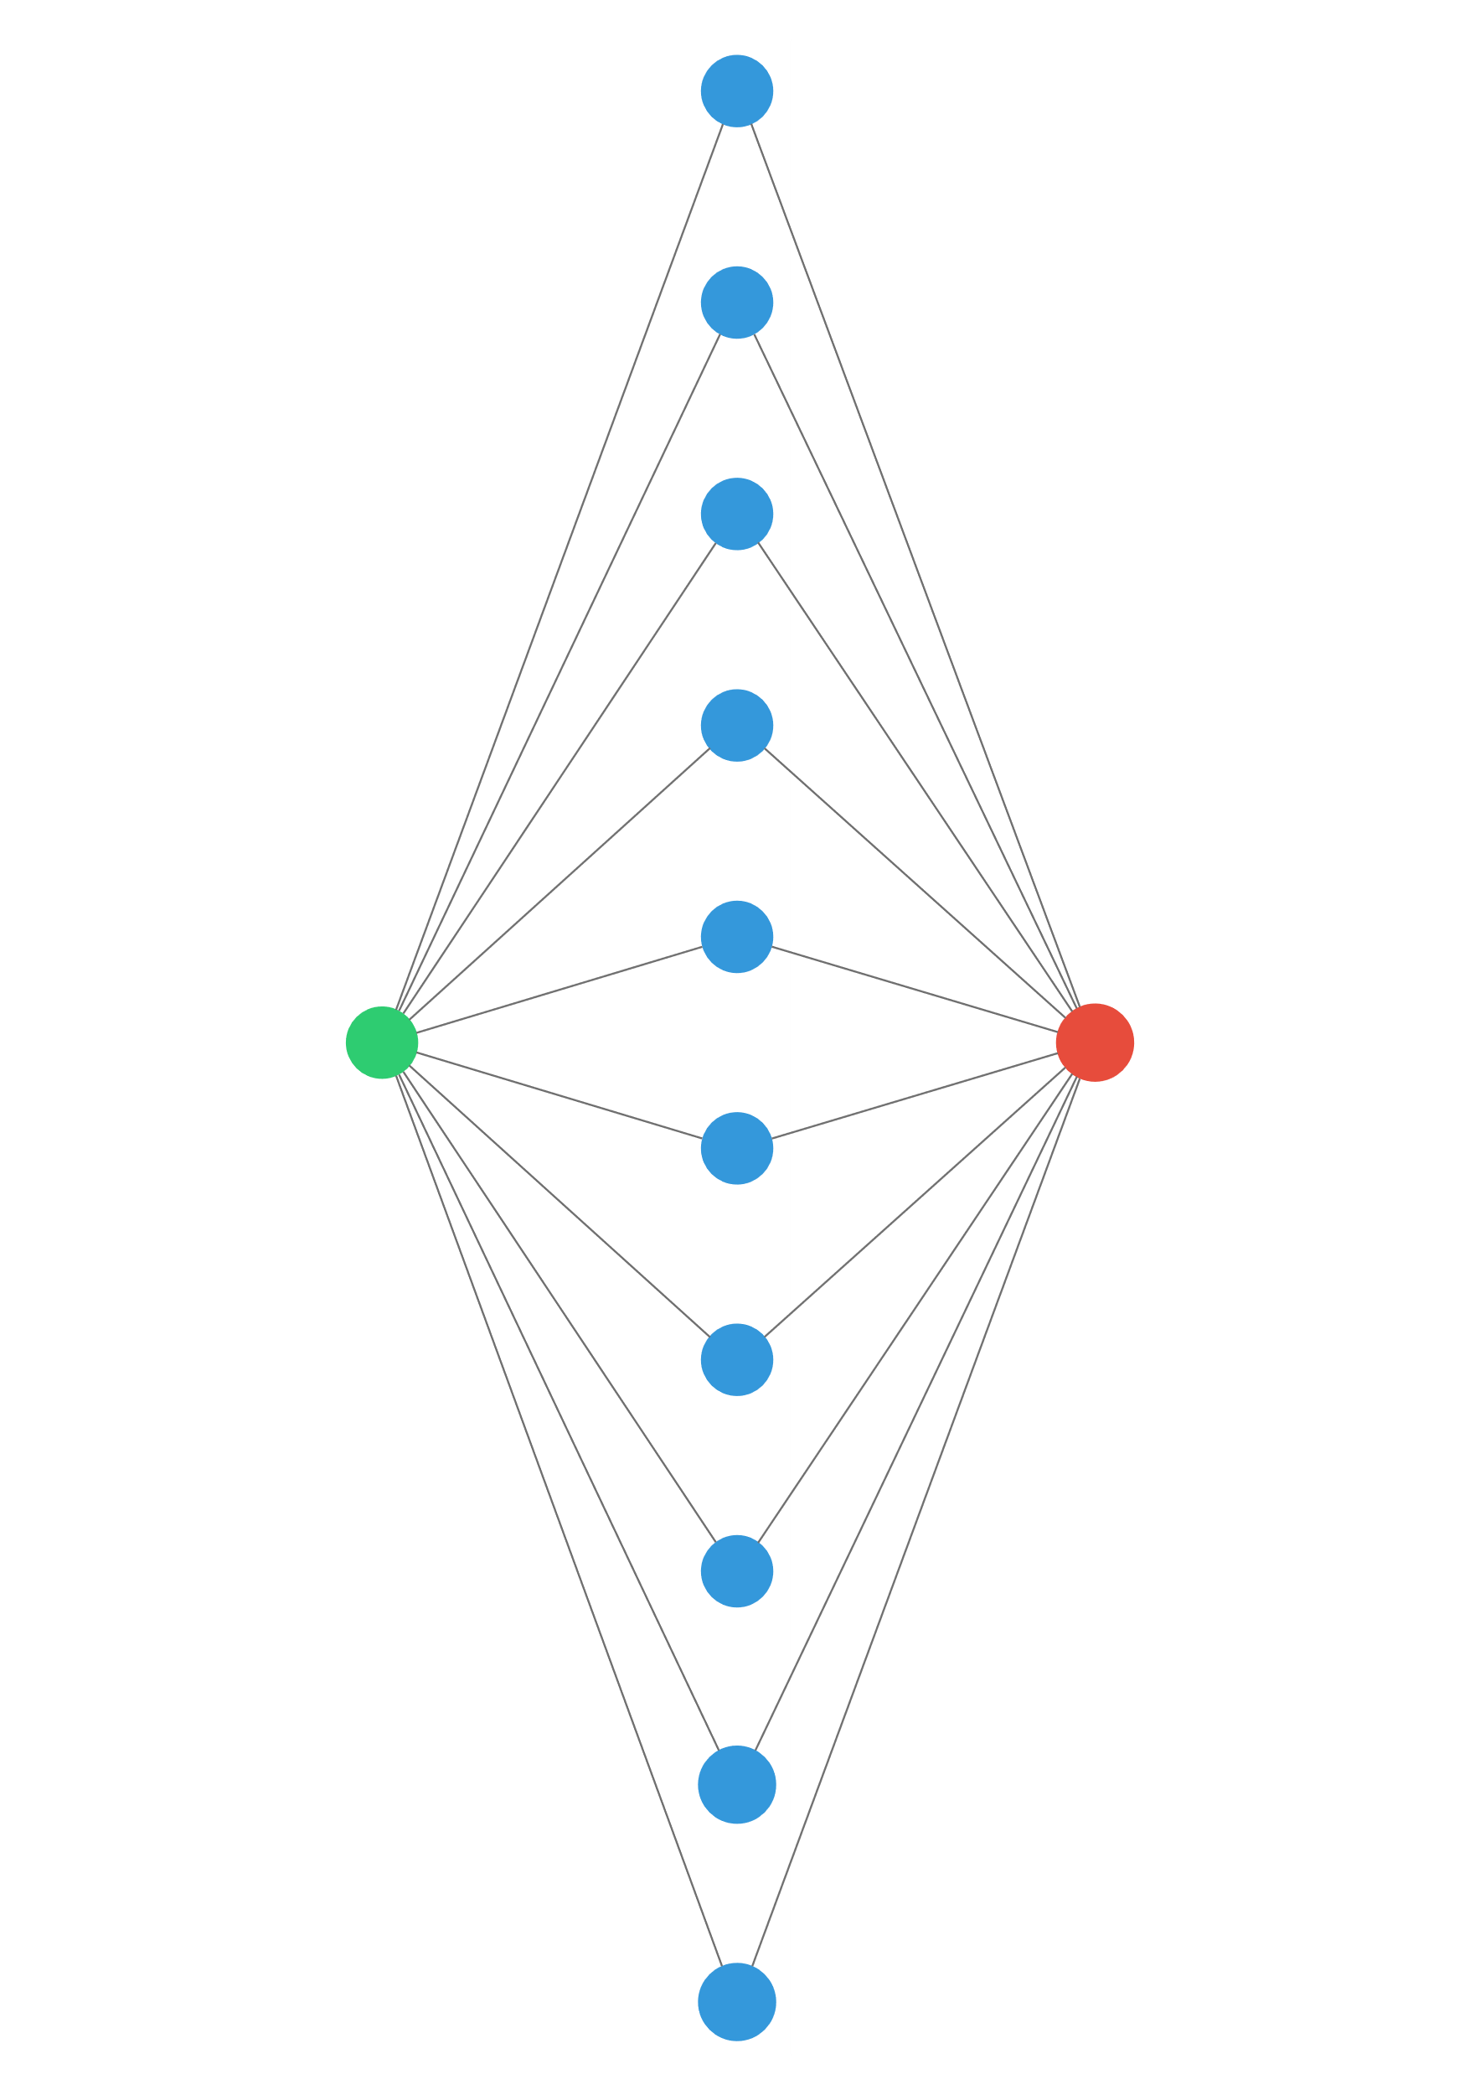
1D perceptron
$$x$$
$$y$$
“any continuous function can be approximated by a 1 hidden layer perceptron” (with ReLU activation)
… provided there are enough neurons in the middle layer!

Slide 5
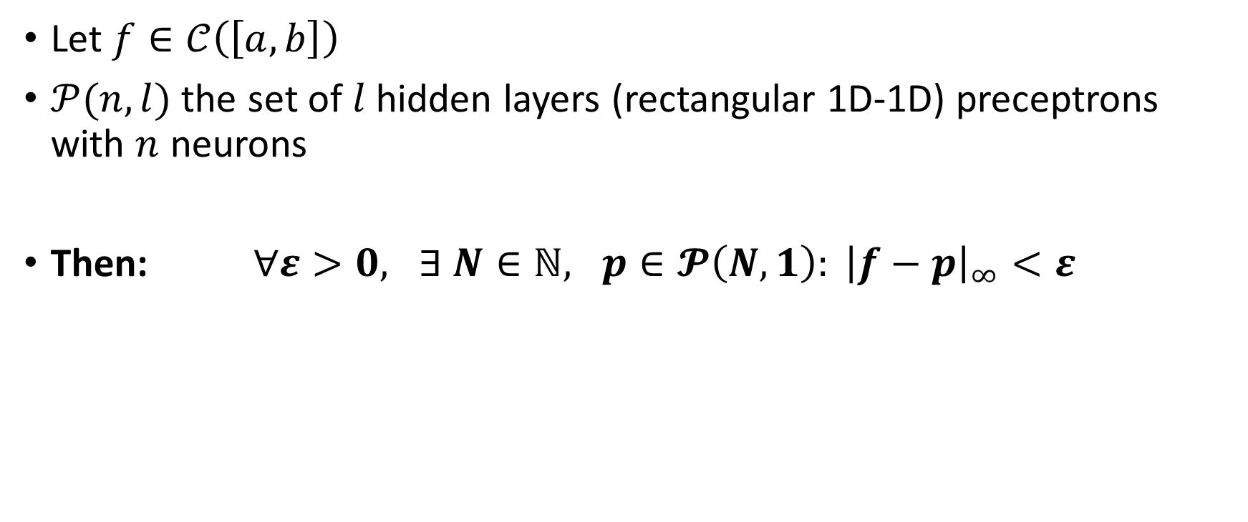
Theorem
Let $f∈𝒞\left(\left[a,b\right]\right)$
$𝒫(n, l)$ the set of $l$ hidden layers (rectangular 1D-1D) preceptrons with $n$ neurons
Then: $∀ε>0, ∃ N∈ℕ, p∈𝓟\left(N,1\right): {\left|f−p\right|}_{∞}<ε$

Slide 6
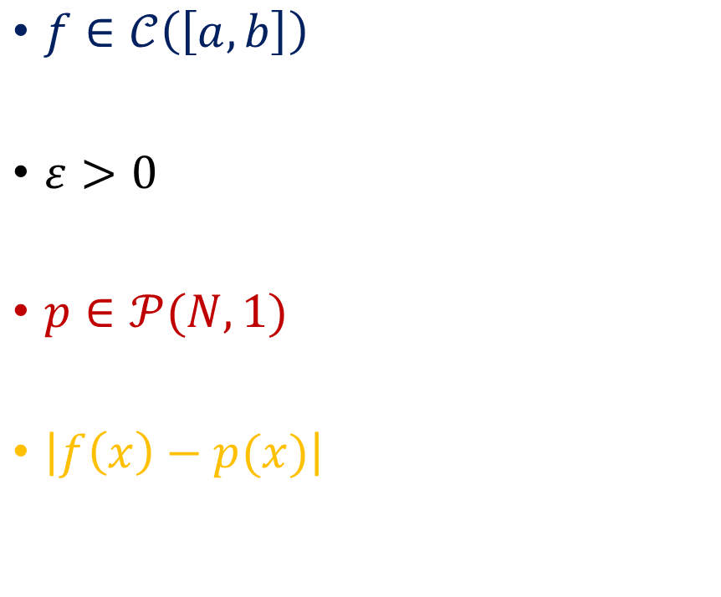
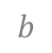
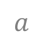
Proof
$f∈𝒞\left(\left[a,b\right]\right)$
$ε>0$
$p∈𝒫(N,1)$
$\left|f\left(x\right)−p(x)\right|$
$$a$$
$$b$$

Slide 7
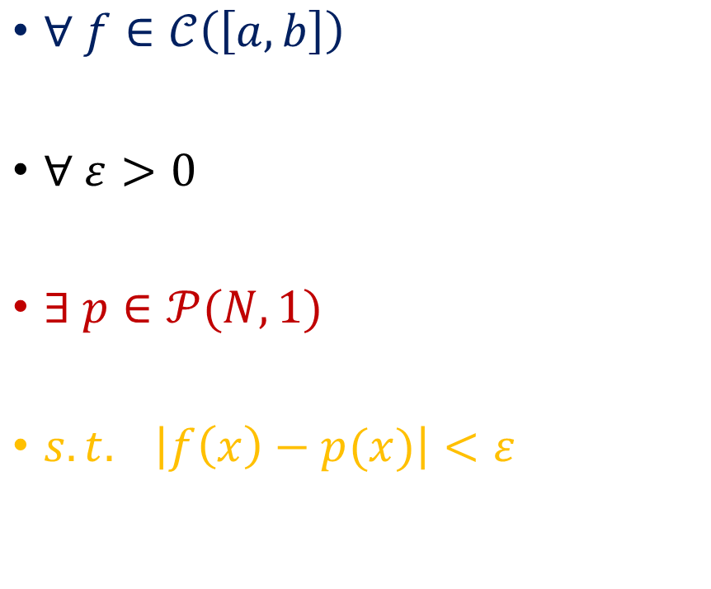
Goal
$∀ f∈𝒞\left(\left[a,b\right]\right)$
$∀ ε>0$
$∃ p∈𝒫(N,1)$
$s.t. \left|f\left(x\right)−p(x)\right|<ε$
$$a$$
$$b$$

Slide 8
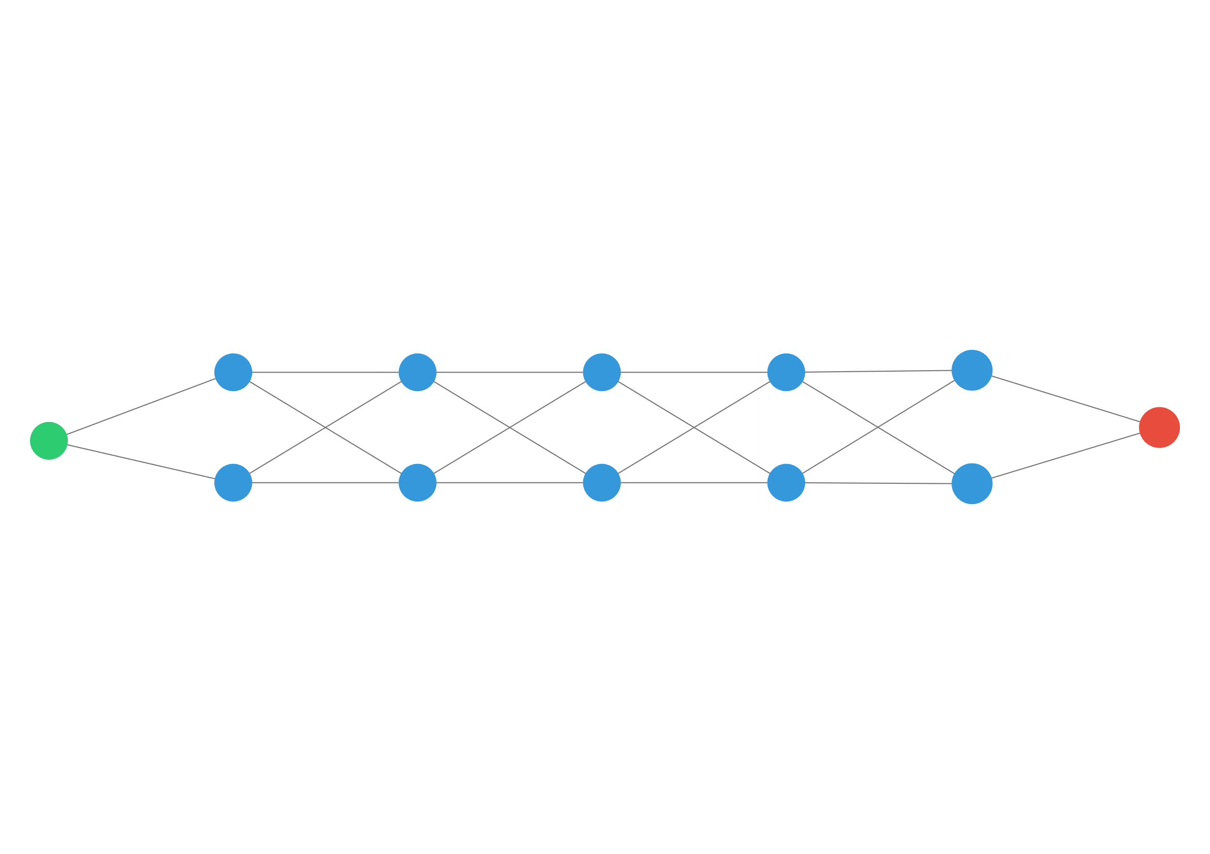
So… wide networks are better?
?
>

Slide 9
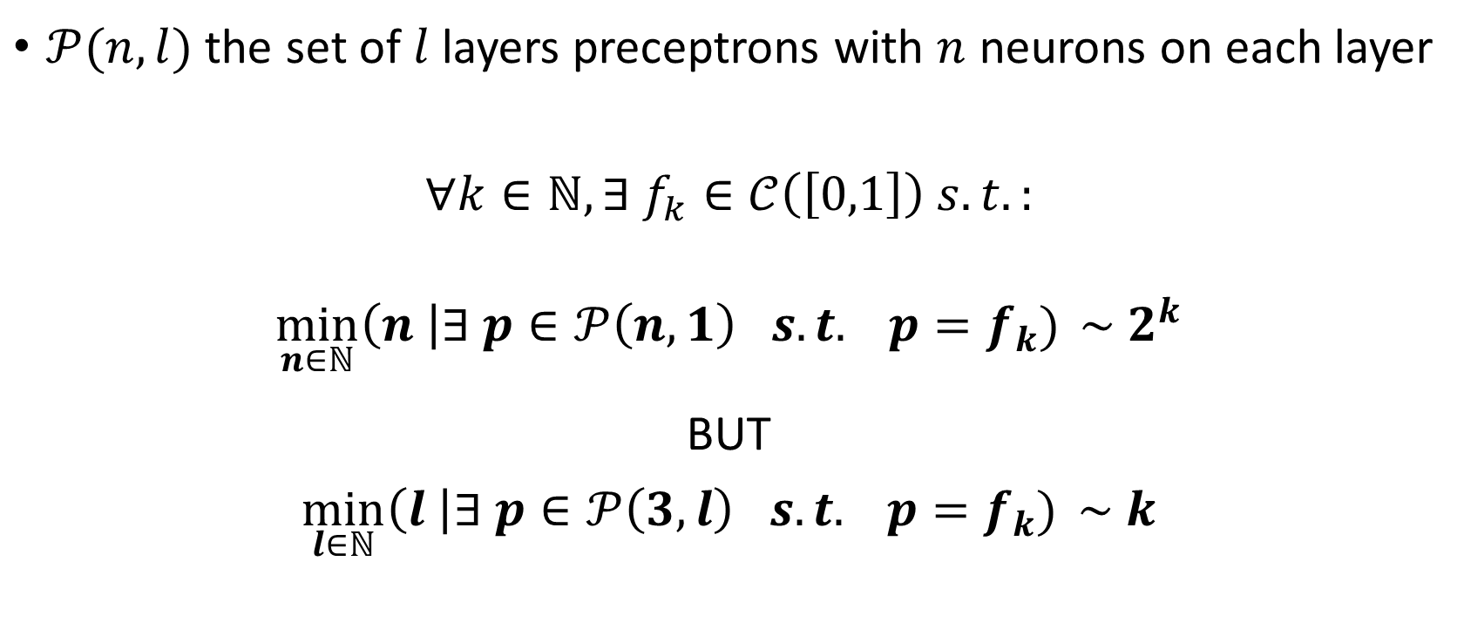
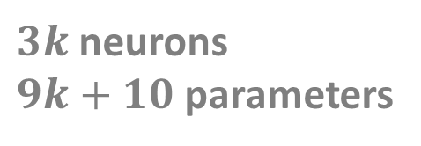
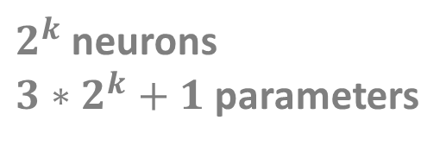
Theorem
$𝒫(n,l)$ the set of $l$ layers preceptrons with $n$ neurons on each layer
$∀k∈ℕ, ∃ f_{k}∈𝒞\left(\left[0,1\right]\right) s.t.:$
$$\min_{n∈ℕ}\left(n \right|∃ p∈𝒫\left(n,1\right) s.t. p=f_{k}) \sim 2^{k}$$
BUT
$$\min_{l∈ℕ}\left(l \right|∃ p∈𝒫\left(3,l\right) s.t. p=f_{k}) \sim k$$
$2^{k}$ neurons
$3∗2^{k}+1$ parameters
$3k$ neurons
$9k+10$ parameters
Notes:
This example will be extensively discussed in the TD4.

Slide 10
So… deep networks are better?
?
<

Slide 11

Convolutional layer
Image credit for this section: “A Comprehensive Guide to Convolutional Neural Networks“
https://towardsdatascience.com/a-comprehensive-guide-to-convolutional-neural-networks-the-eli5-way-3bd2b1164a53

Slide 12
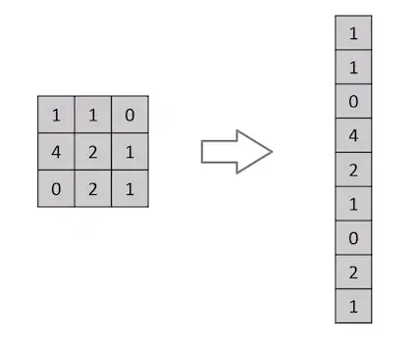

What is wrong with dense layers?

Slide 13

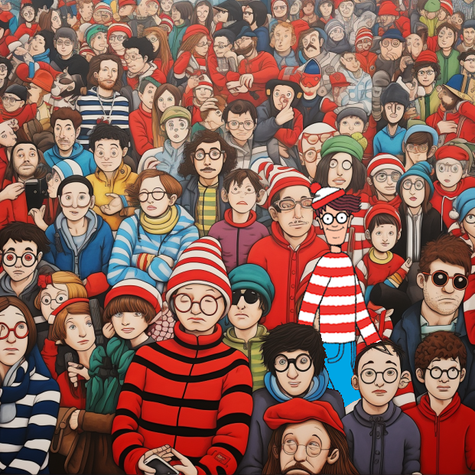
Where is Wally?
Found!

Slide 14

What is a convolution?
1 | 0 | 1
0 | 1 | 0
1 | 0 | 1
“Kernel”

Slide 15
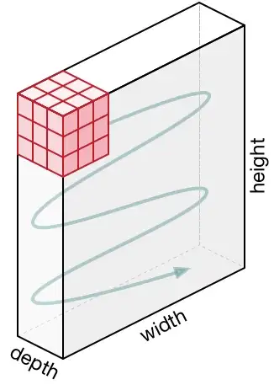

What if image is RGB?

Slide 16

Plain Convolution
Animations credits for this section: https://github.com/vdumoulin/conv_arithmetic/blob/master/README.md
Notes:
Now that we understand the general principle of convolutions, let’s look at addons.
First, we see that the output is smaller than the input (unless the kernel is 1x1); can we try to have an output image that is the same size as the input image?

Slide 17

Padding
Padding
Notes:
Yes! By adding some padding. NB: we can add different type of padding: zeros; specific values; torus; reflection; edges…
This also enables us to better capture what is happening near the edges.
NB: this padding technique is not always used, as not much Is happening on the edges, and we usually want to reduce the size of images.
Now, the images are usually very big, we would like to reduce their dimension, how can we do that?

Slide 18

Striding
Striding
Notes:
Striding manages to reduce the dimension
Can we try to produce better kernels?

Slide 19

Dilation
1 | 0 | 1
0 | 1 | 0
1 | 0 | 1
Dilation
1 |  | 0 |  | 1
0 |  | 1 |  | 0
1 |  | 0 |  | 1
Notes:
Dilation enables us to have larger kernels without increasing the number of parameters.
NB: this dilation technique is not commonly used.

Slide 20
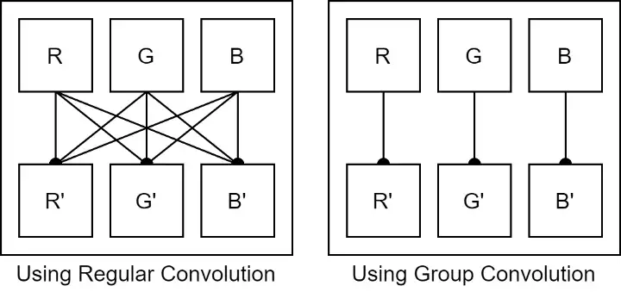
Group convolution
Notes:
Group Convolution enables us to have smaller kernels thus reducing the number of parameters.
NB: this grouping technique is not commonly used, as convolutions have few parameters (compared to dense, for example)

Slide 21
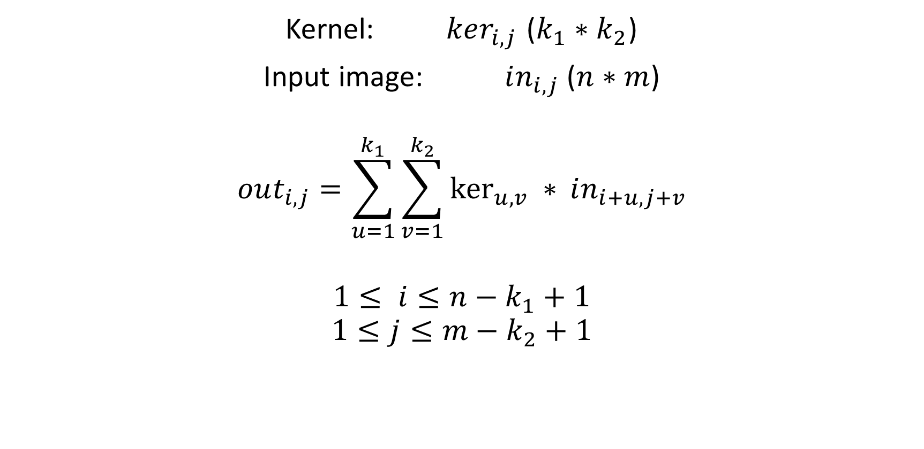
Convolution output formula: plain
Kernel: $ker_{i,j}$ ($k_{1}∗k_{2}$)
Input image: $in_{i,j}$ ($n∗m$)
$$out_{i,j}=\sum_{u=1}^{k_{1}}{\sum_{v=1}^{k_{2}}{\ker_{u,v} ∗{in_{i+u,j+v}}}}$$
$$1≤ i≤n−k_{1}+1$$
$$1≤j≤m−k_{2}+1$$

Slide 22
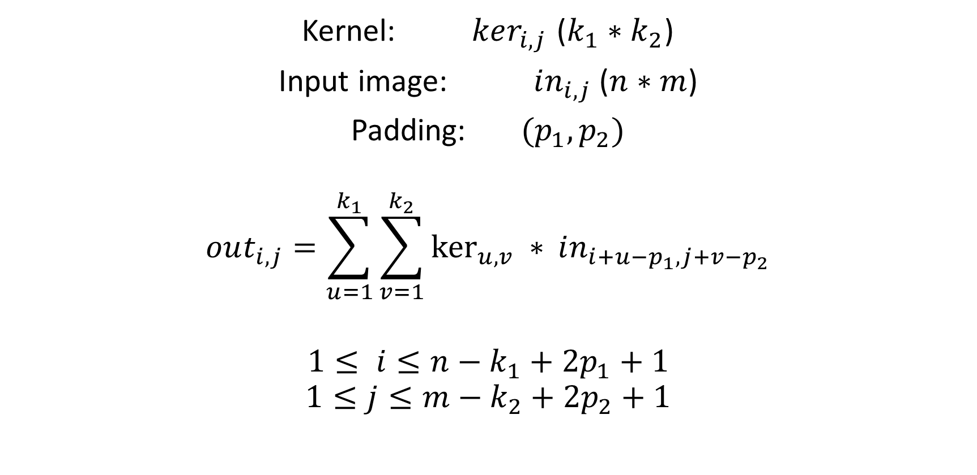
Convolution output formula: padding
Kernel: $ker_{i,j}$ ($k_{1}∗k_{2}$)
Input image: $in_{i,j}$ ($n∗m$)
Padding: $(p_{1},p_{2})$
$$out_{i,j}=\sum_{u=1}^{k_{1}}{\sum_{v=1}^{k_{2}}{\ker_{u,v} ∗{in_{i+u−p_{1},j+v−p_{2}}}}}$$
$$1≤ i≤n−k_{1}+2p_{1}+1$$
$$1≤j≤m−k_{2}+2p_{2}+1$$

Slide 23
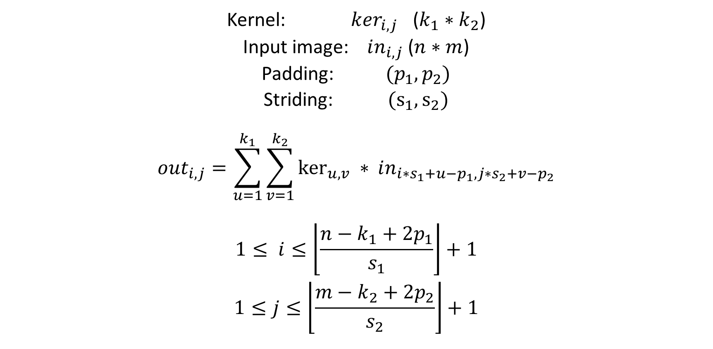
Convolution output formula: striding
Kernel: $ker_{i,j}$ ($k_{1}∗k_{2}$)
Input image: $in_{i,j}$ ($n∗m$)
Padding: $(p_{1},p_{2})$
Striding: $(s_{1},s_{2})$
$$out_{i,j}=\sum_{u=1}^{k_{1}}{\sum_{v=1}^{k_{2}}{\ker_{u,v} ∗{in_{i∗s_{1}+u−p_{1},j∗s_{2}+v−p_{2}}}}}$$
$$1≤ i≤\left\lfloor \frac{n−k_{1}+2p_{1}}{s_{1}}\right\rfloor +1$$
$$1≤j≤\left\lfloor \frac{m−k_{2}+2p_{2}}{s_{2}}\right\rfloor +1$$

Slide 24
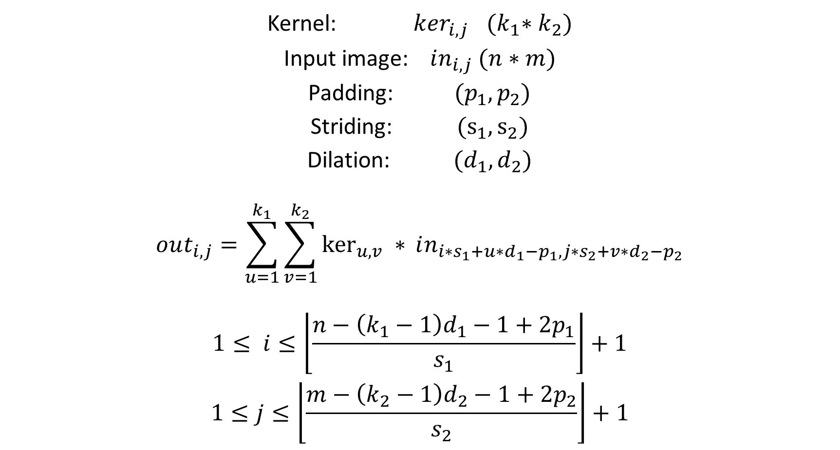
Convolution output formula: dilation
Kernel: $ker_{i,j}$ ${(k}_{1}∗k_{2})$
Input image: $in_{i,j}$ $(n∗m)$
Padding: $(p_{1},p_{2})$
Striding: $(s_{1},s_{2})$
Dilation: $(d_{1},d_{2})$
$$out_{i,j}=\sum_{u=1}^{k_{1}}{\sum_{v=1}^{k_{2}}{\ker_{u,v} ∗{in_{i∗s_{1}+u∗d_{1}−p_{1},j∗s_{2}+v∗d_{2}−p_{2}}}}}$$
$$1≤ i≤\left\lfloor \frac{n−\left(k_{1}−1\right)d_{1}−1+2p_{1}}{s_{1}}\right\rfloor +1$$
$$1≤j≤\left\lfloor \frac{m−\left(k_{2}−1\right)d_{2}−1+2p_{2}}{s_{2}}\right\rfloor +1$$

Slide 25
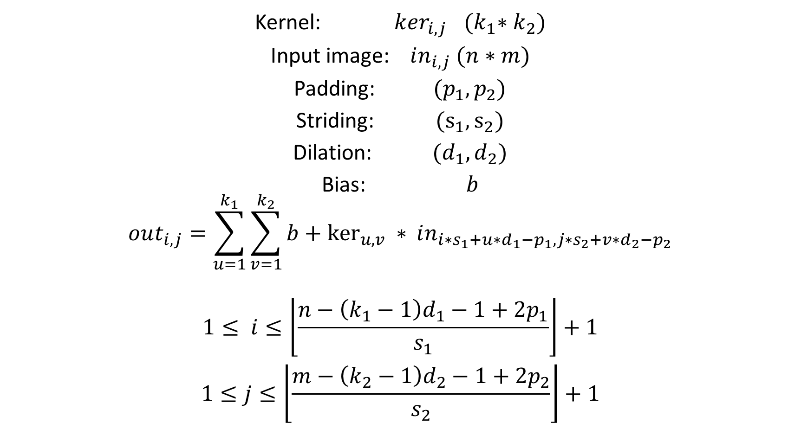
Convolution output formula: bias
Kernel: $ker_{i,j}$ ${(k}_{1}∗k_{2})$
Input image: $in_{i,j}$ $(n∗m)$
Padding: $(p_{1},p_{2})$
Striding: $(s_{1},s_{2})$
Dilation: $(d_{1},d_{2})$
Bias: $b$
$$out_{i,j}=\sum_{u=1}^{k_{1}}{\sum_{v=1}^{k_{2}}{b+\ker_{u,v} ∗{in_{i∗s_{1}+u∗d_{1}−p_{1},j∗s_{2}+v∗d_{2}−p_{2}}}}}$$
$$1≤ i≤\left\lfloor \frac{n−\left(k_{1}−1\right)d_{1}−1+2p_{1}}{s_{1}}\right\rfloor +1$$
$$1≤j≤\left\lfloor \frac{m−\left(k_{2}−1\right)d_{2}−1+2p_{2}}{s_{2}}\right\rfloor +1$$

Slide 26
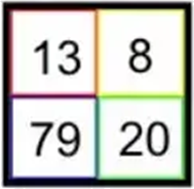
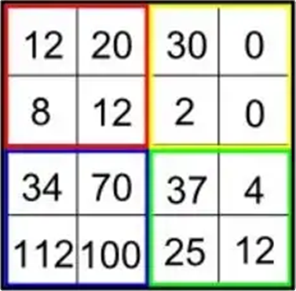
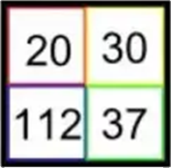
Pooling layer
Average pooling
Max pooling
Notes:
Another technique to reduce the images dimension is to add pooling layers: divide the images to rectangles, and either take the average value, or the maximum.
Note that max pooling is much more popular than the average.
In fact, average pooling is a convolution, with a uniform kernel, while max pooling introduces non-linearity.

Slide 27
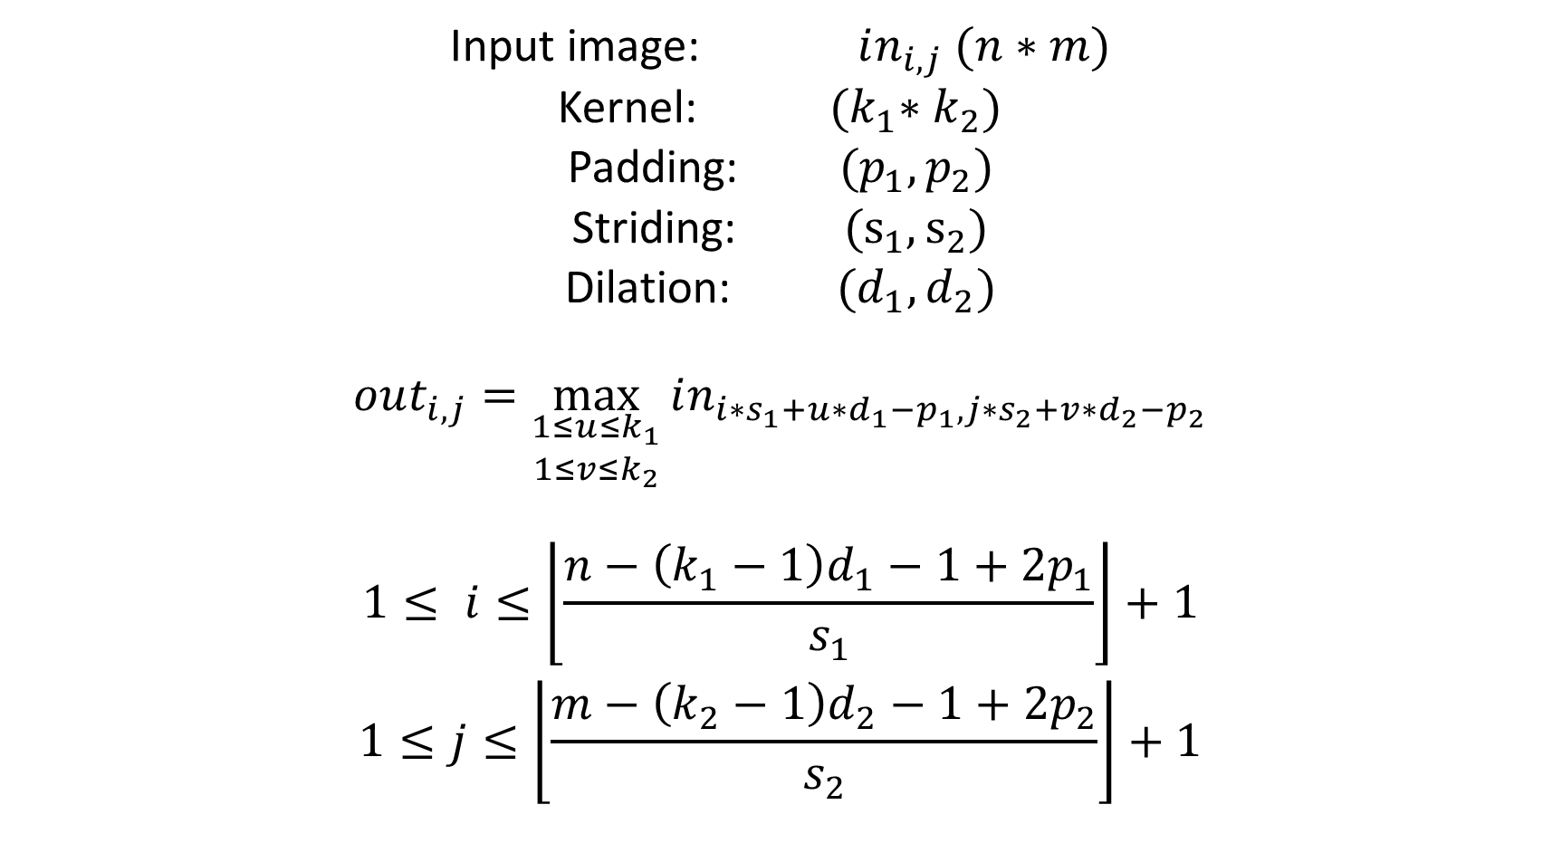
Max pooling output formula
Input image: $in_{i,j}$ $(n∗m)$
Kernel: ${(k}_{1}∗k_{2})$
Padding: $(p_{1},p_{2})$
Striding: $(s_{1},s_{2})$
Dilation: $(d_{1},d_{2})$
$$out_{i,j}=\max_{\begin{aligned}1≤u≤k_{1} \\ 1≤v≤k_{2}\end{aligned}}{in_{i∗s_{1}+u∗d_{1}−p_{1},j∗s_{2}+v∗d_{2}−p_{2}}}$$
$$1≤ i≤\left\lfloor \frac{n−\left(k_{1}−1\right)d_{1}−1+2p_{1}}{s_{1}}\right\rfloor +1$$
$$1≤j≤\left\lfloor \frac{m−\left(k_{2}−1\right)d_{2}−1+2p_{2}}{s_{2}}\right\rfloor +1$$

Slide 28
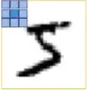
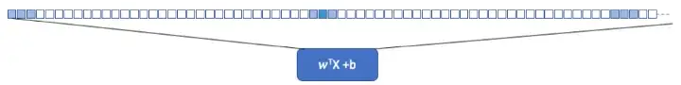
Comparison with dense
Convolution
Dense equivalent

Slide 29
SoftMax Layer
2
0.5
3.2
9.8
1.7
4.2
0.09345794
0.02336449
0.14953271
0.45794393
0.07943925
0.19626168
Normalize
(divide by the norm)

Slide 30
SoftMax Layer
-2
0.5
3.2
9.8
1.7
4.2
-0.11494253
0.02873563
0.18390805
0.56321839
0.09770115
0.24137931
Normalize
(divide by the norm)

Slide 31
SoftMax Layer
-2
0.5
3.2
9.8
1.7
4.2
0.135335283
1.64872127
24.5325302
18033.7449
5.47394739
66.6863310
0.0000746380034
0.0000909277026
0.00135297982
0.994568958
0.000301890604
0.00367778046
Take Exponential
Normalize

Slide 32
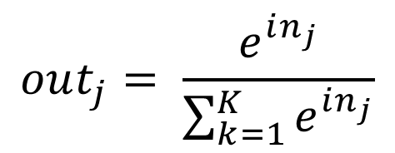
SoftMax Layer
-2
0.5
3.2
9.8
1.7
4.2
-0.11494253
0.02873563
0.18390805
0.56321839
0.09770115
0.24137931
Take SoftMax
(take exponential, then
divide by the norm)
$$out_{j}= \frac{e^{in_{j}}}{\sum_{k=1}^{K}{e^{in_{j}}}}$$

